Slide 1
THE BRENTHURST FOUNDATION China in Southern Africa: Bleak view from the street Terence McNamee

Slide 2
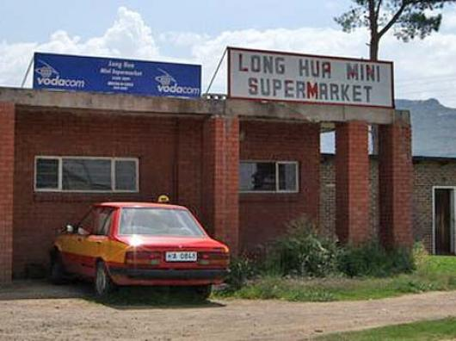

Slide 3
The Brenthurst Project
200 interviews, 5 countries

Slide 4
Key Findings
Africa draws the poorest and least educated of the overseas Chinese Diaspora.

Slide 5
Key Findings
Africa has the poorest and least educated of the overseas Chinese Diaspora.
Chinese traders are in Africa because they could not make a living in China

Slide 6
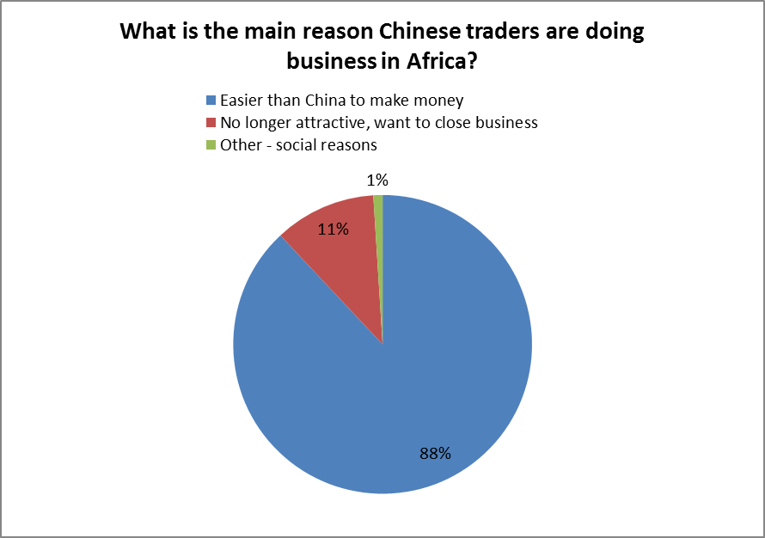

Slide 7
Key Findings
Africa has the poorest and least educated of the overseas Chinese Diaspora.
Chinese traders are in Africa because China has become too competitive
Chinese migrants have forged their own pathways in Africa

Slide 8
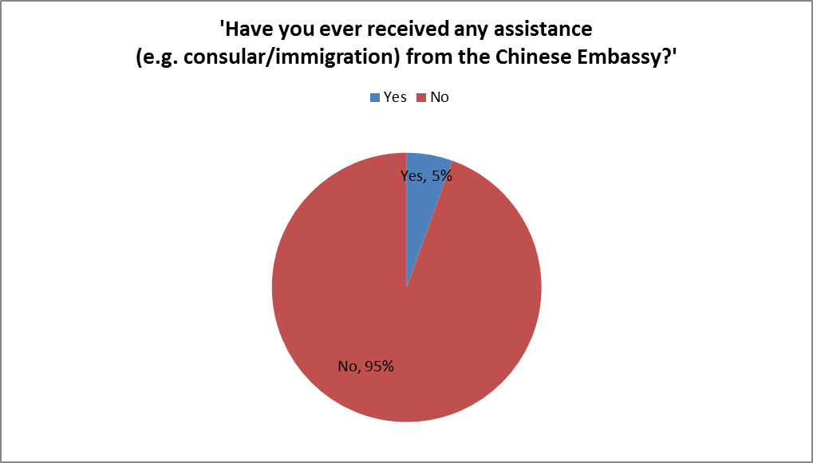

Slide 9
Key Findings
Africa has the poorest and least educated of the overseas Chinese Diaspora.
Chinese traders are in Africa because China has become too competitive
Chinese migrants have forged their own pathways in Africa
More than half are from Fuijan Province

Slide 10
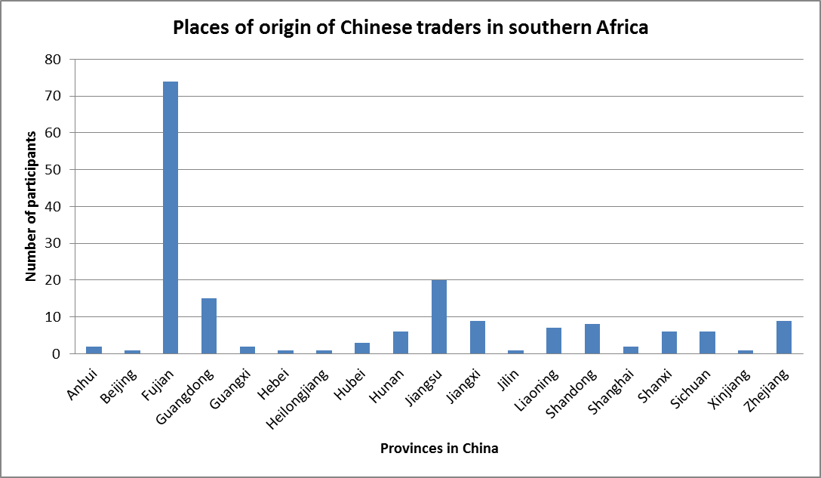

Slide 11
Chinese traders have been successful with small businesses in Africa where local firms have failed or feared to tread

Slide 13
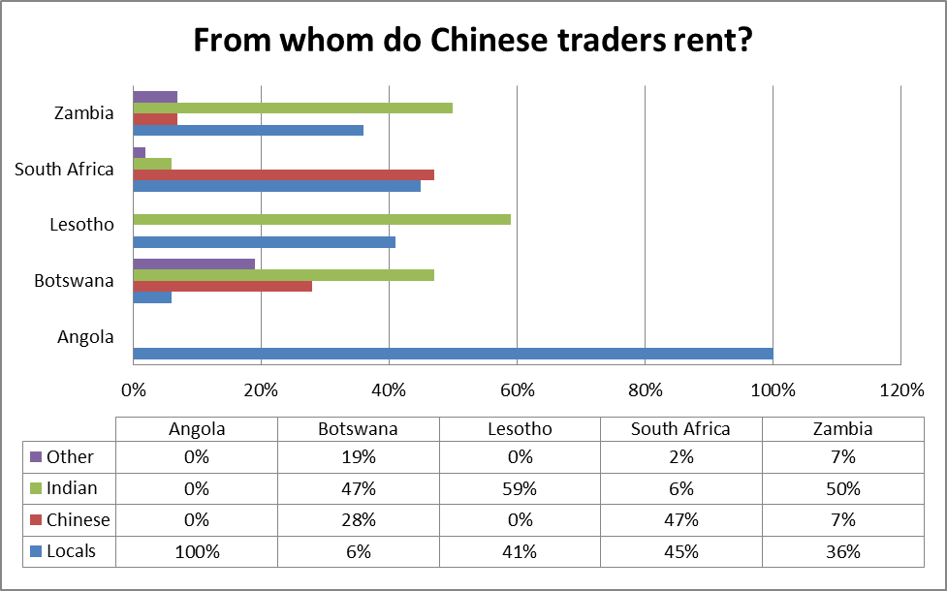

Slide 14
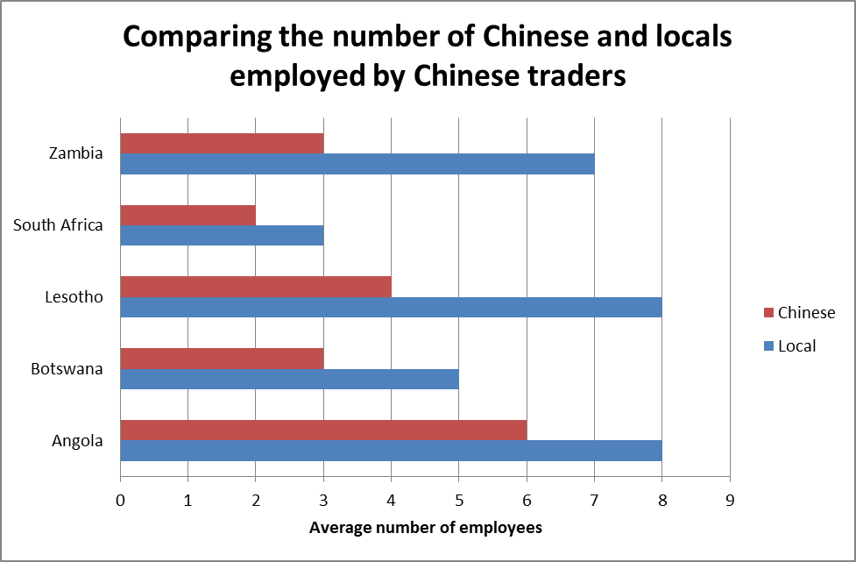

Slide 15
Chinese traders have been successful with smalls businesses in Africa where local firms have failed or feared to tread
Business is becoming more competitive

Slide 16
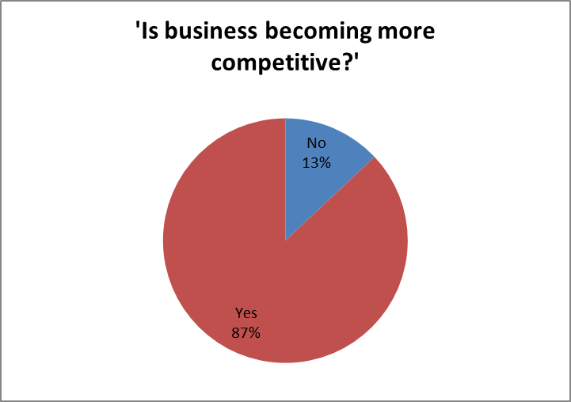

Slide 17
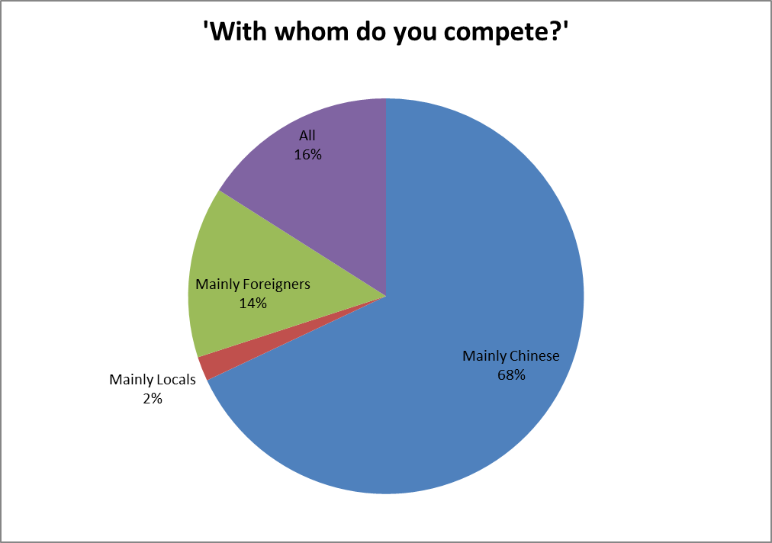

Slide 18
Chinese traders have been successful with smalls businesses in Africa where local firms have failed or feared to tread
Business is becoming more competitive
Relations between Chinese traders and African communities are deteriorating

Slide 19
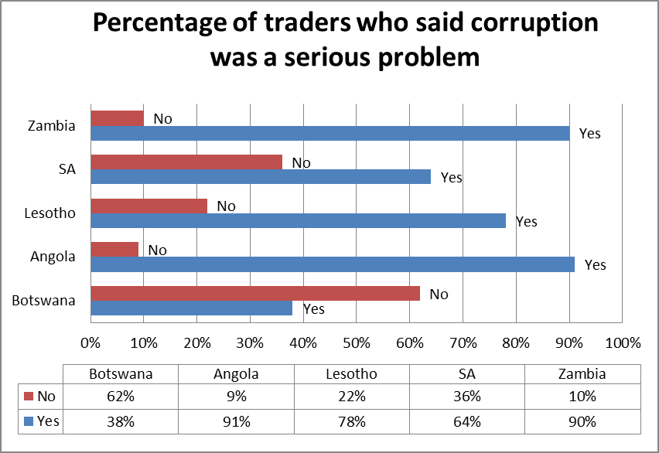

Slide 21
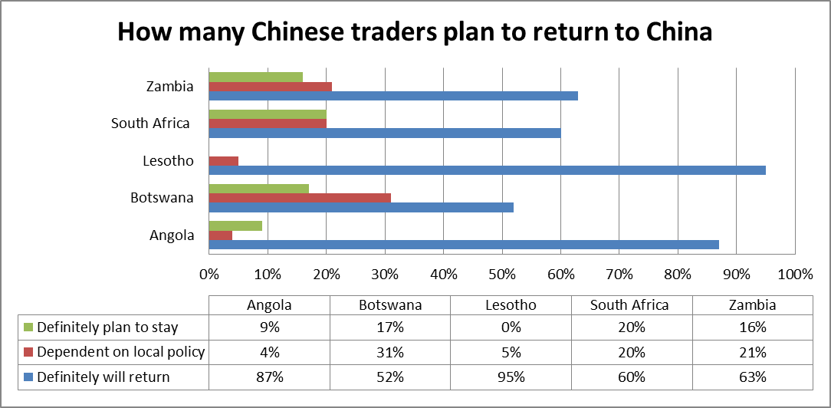

Slide 23
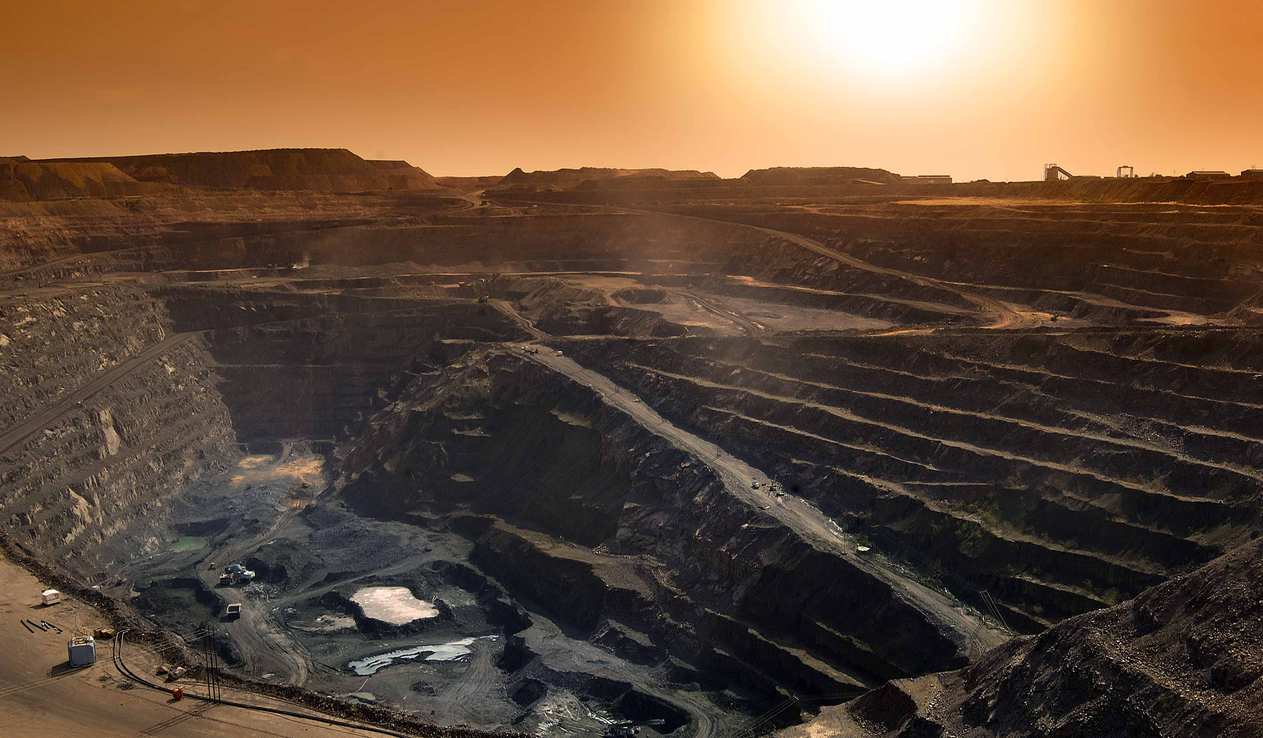
Africa’s Globalisation Link
Africa’s Globalisation Link
Western consumer demand
Asian production & savings

Slide 24
Responding to the rising tide of violence?

Slide 25
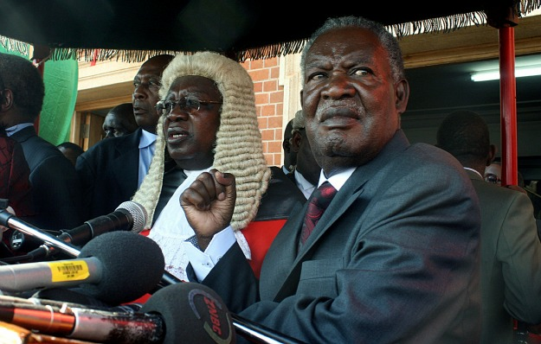
Notes:
25

Slide 26
A final question
How will they respond to new legislation….
Will tighter regulatory frameworks make Africa a much less attractive place for Chinese traders to do business, perhaps even mark the decline of the Chinese shop?
Or will the qualities exemplified by unemployed factory workers and farmers from Fuijan, who succeeded as traders in the continent’s remotest villages and toughest neighbourhoods, see them through the new legislation and enable them to continue to thrive?
Notes:
26

Slide 28
The END

