Slide 1
Migrants in the informal sector: The case of Zimbabweans in South Africa
Godfrey Tawodzera
African Centre for Cities (ACC), University of Cape Town

Slide 2
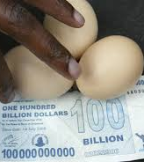
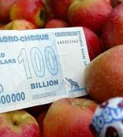
Two decades of political and economic problems have transformed Zimbabwe into a migrant-sending country

Slide 3
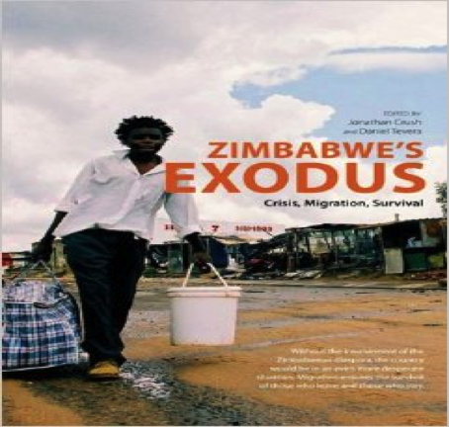
Exodus – Crush & Tevera, 2010

Slide 4
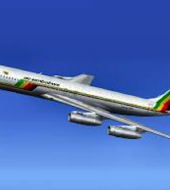
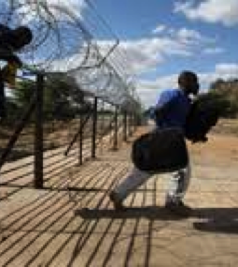
Emigrants to regional and international destinations
Notes:
Popular destinations include SA, Botswana, UK, US, Canada, New Zealand, Australia

Slide 5
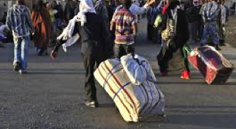
Most estimates put the number of Zimbabweans in South Africa at 1.5 – 3 million (Crush & Tevera, 2010)
Notes:
Exact number of Zimbabweans in SA is not known, various estimates, some journalistic etc

Slide 6
Asylum applications by Zimbabweans in South Africa
Year | No
2000 | 0
2001 | 4
2002 | 115
2003 | 2588
2004 | 5789
2005 | 7783
2006 | 18973
2007 | 17667
2008 | 111968
2009 | 149453
Notes:
Source: Department of Home Affairs

Slide 7
Revised estimates for Zimbabwean population in South Africa
Year | Annual growth rate (%) | Estimated migrant population (Makina) | Revised estimate of black migrant population (SAMP)
2001 |  | 131 866 | 66 033
2002 | 33 | 175 715 | 87 824
2003 | 45 | 255 604 | 127 345
2004 | 47 | 375 935 | 187 197
2005 | 39 | 522 364 | 260 204
2006 | 46 | 763 425 | 379 898
2007 | 36 | 1 022 965 | 509 063
Notes:
The 2001 Census recorded a total of 131 886 Zimbabwean-born people in South Africa, 50% of whom were black. Using the 2001 census figure as a baseline, and the rate of growth of the Zimbabwean population in Johannesburg, Makina estimated that there were 1 022 965 Zimbabweans in South Africa. However, this assumes that the rate of increase of the black Zimbabwean population in South Africa was the same as the white, which seems highly unlikely. So SAMP used 66 033 as the baseline to estimate the black population of Zim in SA.

Slide 8
Data from 2010 & 2012 SAMP studies in in Cape Town & Johannesburg
Focus on general migration issues and food security rather than informality per se
So, data is only indicative rather than conclusive

Slide 9
Employment status prior and post-migration (SAMP, 2010)
 | Prior to migration (%) | After migration (%)
Wage employment | 50 | 62
Informal sector | 8 | 20
Unemployed | 42 | 18

Slide 10
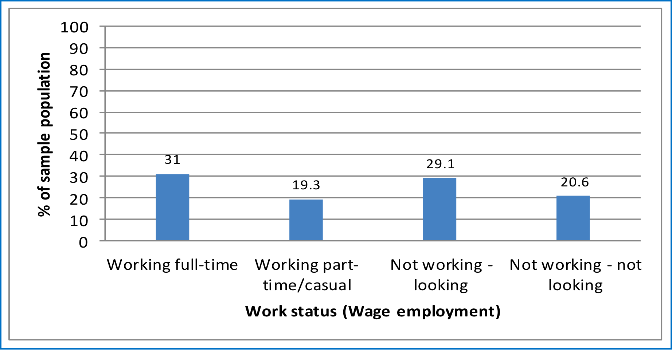
SAMP, 2012
Notes:
Not working – most of these surviving on the informal sector

Slide 11
SAMP, 2010
Changing occupational profile in South Africa
 | 2005(%) | 2010(%)
Manager/employer | 9.5 | 1.0
Professional (inc lawyer, health, teaching) | 37.3 | 14.1
Office worker | 5.3 | 4.1
Manual worker | 6.6 | 23.8 ?
Service worker | 9.5 | 12.6
Domestic worker | 2.4 | 8.4
Student | 1.3 | 2.9
Trader/hawker/vendor | - | 14.3
Security | 0.7 | 4.1
Security | - | 4.1
Never had a job in South Africa | - | 14.1

Slide 12
SAMP, 2010
Other sources of income
 | No | %
Casual work | 177 | 32.4?
Informal sector trading | 58 | 10.6
Social grant | 1 | 0.2
Rentals | 4 | 0.7
Remittances | 10 | 1.8
Borrowing | 74 | 13.6
None | 206 | 37.7
Other source | 16 | 2.9
Total | 546 | 100.0

Slide 14
SAMP, 2012

Slide 15
Notes:
SAMP, 2012: Migrants Food Security

Slide 16
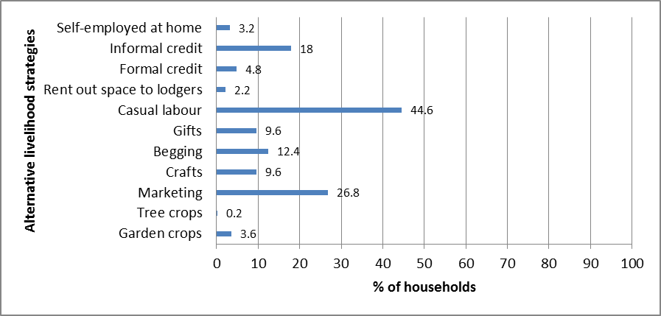
Notes:
SAMP, 2012

Slide 17
Notes:
SAMP, 2012

Slide 18
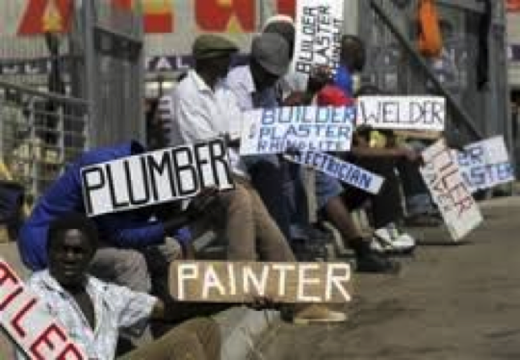
Thank you

