Slide 1
The Sources and range of Food items being traded informally in Harare CBD: assessing the footprint of Harare’s informally sold food
Presented at the Urban Informality and Migrant Entrepreneurship in Southern African Cities Workshop
12 February 2014
Percy Toriro
PRACTICING Urban Planner & Lecturer

Slide 2
Background
For the past 10 years I have been assisting with teaching at the University of Zimbabwe
There are no new publications on planning issues
Harare City (in fact all cities) is facing many urban development challenges
The authorities are so overwhelmed by day-to-day challenges that there is no space for them to think of research
As they try to resolve the challenges, the decision-making process is not evidence-based and may not be sustainable
A few of us have committed to undertaking research for purposes of bringing on board current positions regarding many urban issues in order to support authorities, influence positive policy change whilst developing training materials

Slide 3
Motivation…
There is a vibrant national debate going on in the country
There is a new ‘openness and tolerance’ after the 2013 elections
After the Zanu PF victory, they no longer see the threat of opposition
The opposition itself is severely compromised by internal soul-searching
Issues are being discussed very openly regarding a variety of national issues
An opportunity therefore exists to examine any issue and influence policy positions away from the pressure of elections

Slide 4
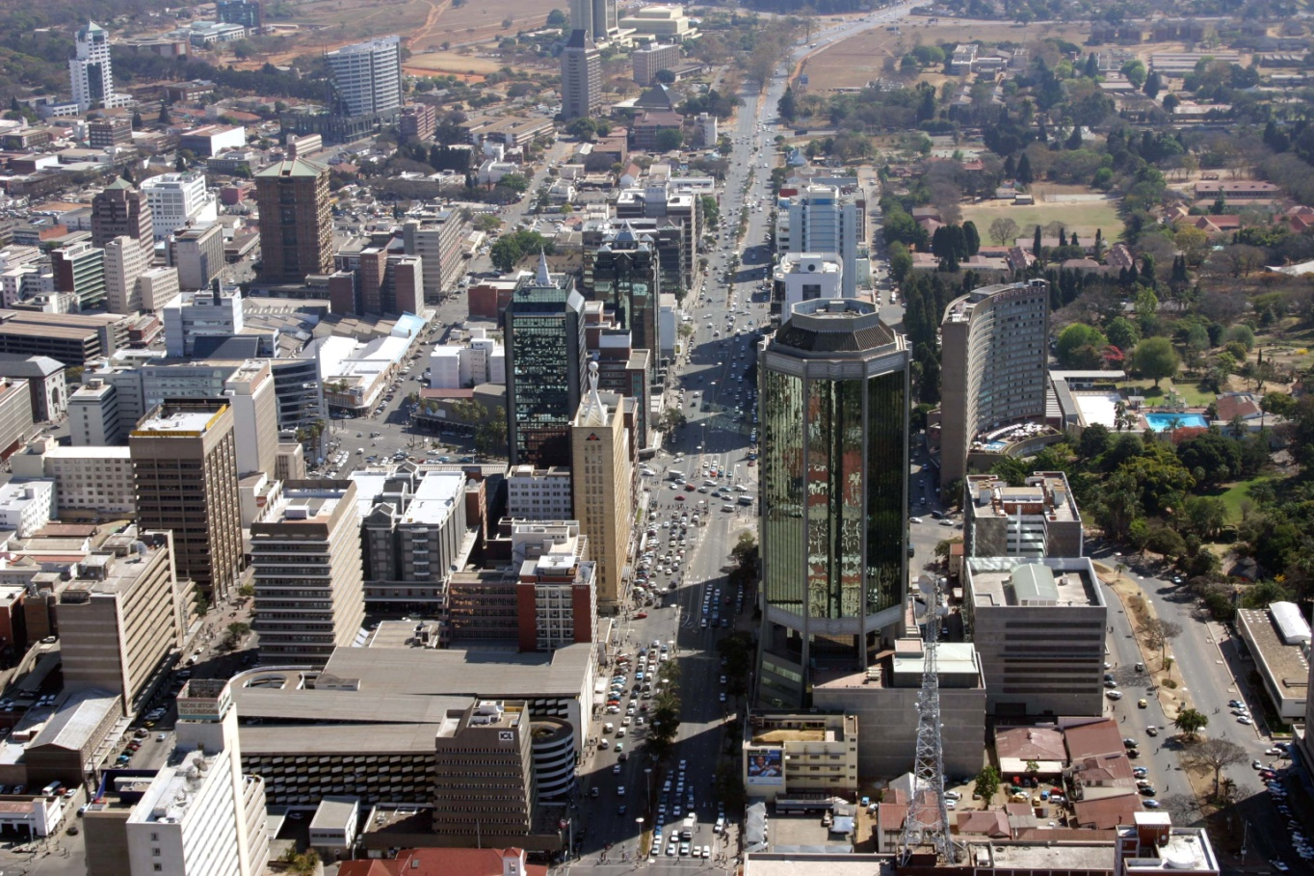
Harare…is beautiful

Slide 5
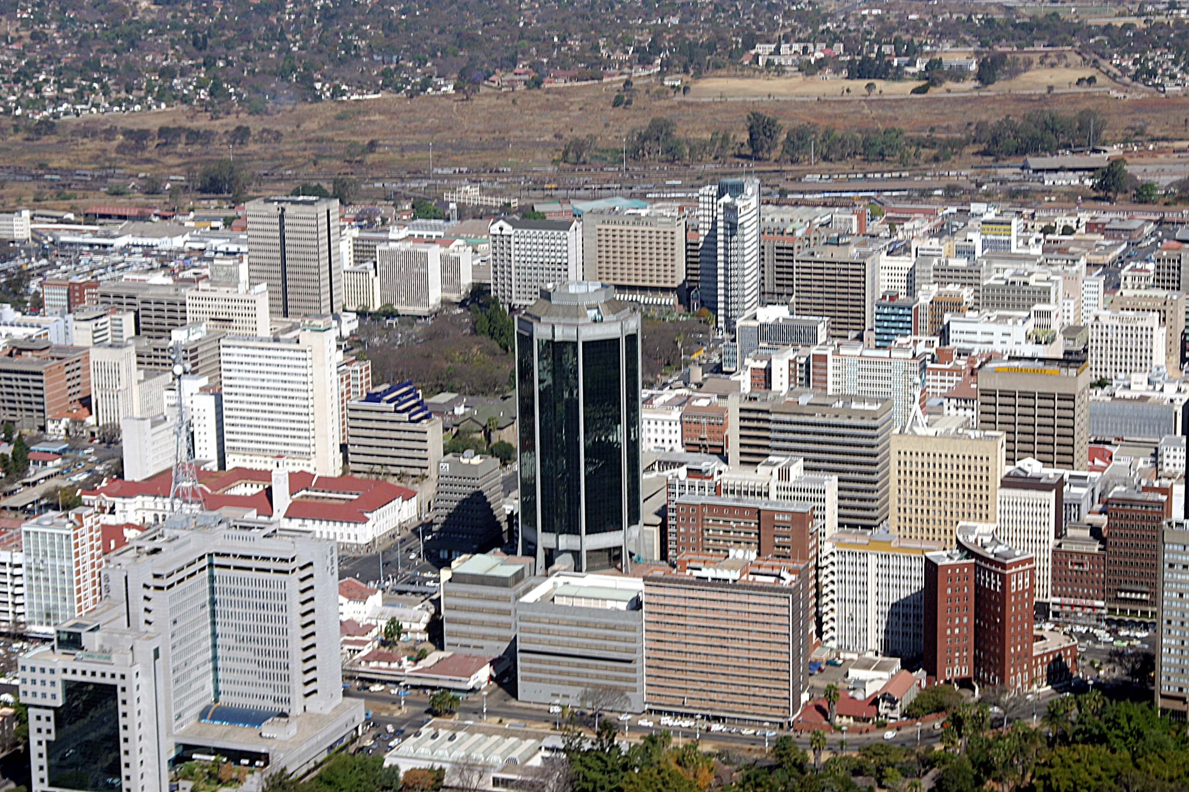
Harare is well-planned

Slide 6
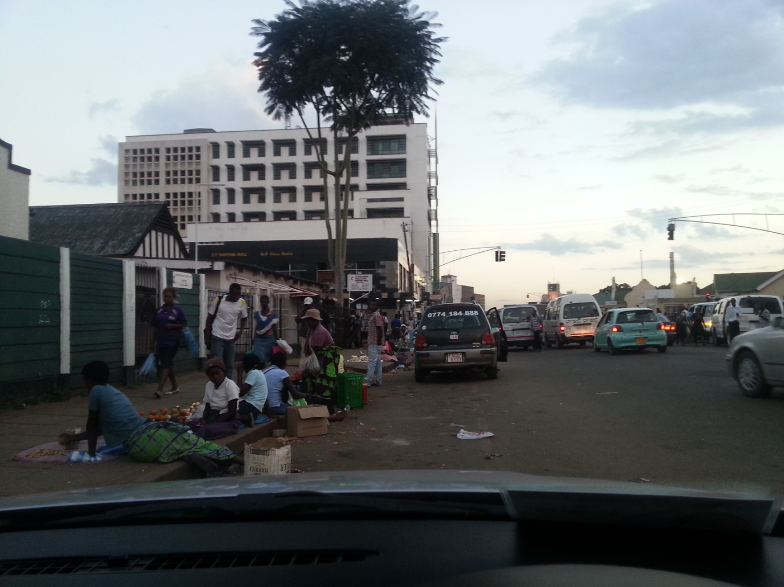
But it’s not all rosy in Harare..

Slide 7
In 2005..
Zimbabwe conducted an urban clean up operation that saw the demolition of anything deemed illegal by the authorities from housing to informal trading infrastructure
The City of Harare then declared that there would be NO INFORMAL TRADING ACTIVITIES IN HARARE CBD
This has been the official position till now

Slide 8
This Research
Sought to establish the range of food items being traded on Harare’s streets
We also wanted to assess where these food items were coming from
We are in the middle of analyzing the data but have extracted issues relevant to this gathering

Slide 9
Methods Used
Field Observation in the sampled areas
Interviews with 120 traders on the streets
Mapping of traders numbers and positions
Key informant interview with representatives of authorities and civil society groups

Slide 10
The Research Sites…major pedestrian corridors near bus termini with high numbers of traders

Slide 11
Sex of the interviewed 120 respondents

Slide 12
The majority of the informal traders are aged between 18 and 40 years

Slide 13
Status of trader in the family

Slide 14
What is the level of education of respondents? N=120

Slide 15
Origin of Street Food Vendors….47% ‘migrants’

Slide 16
Typology of traders
Majority (95%) are small-scale and trade from the street pavements
About 4% use pushcarts and are mobile although they can also park and trade
Very few less than 1% trade from vehicles

Slide 17
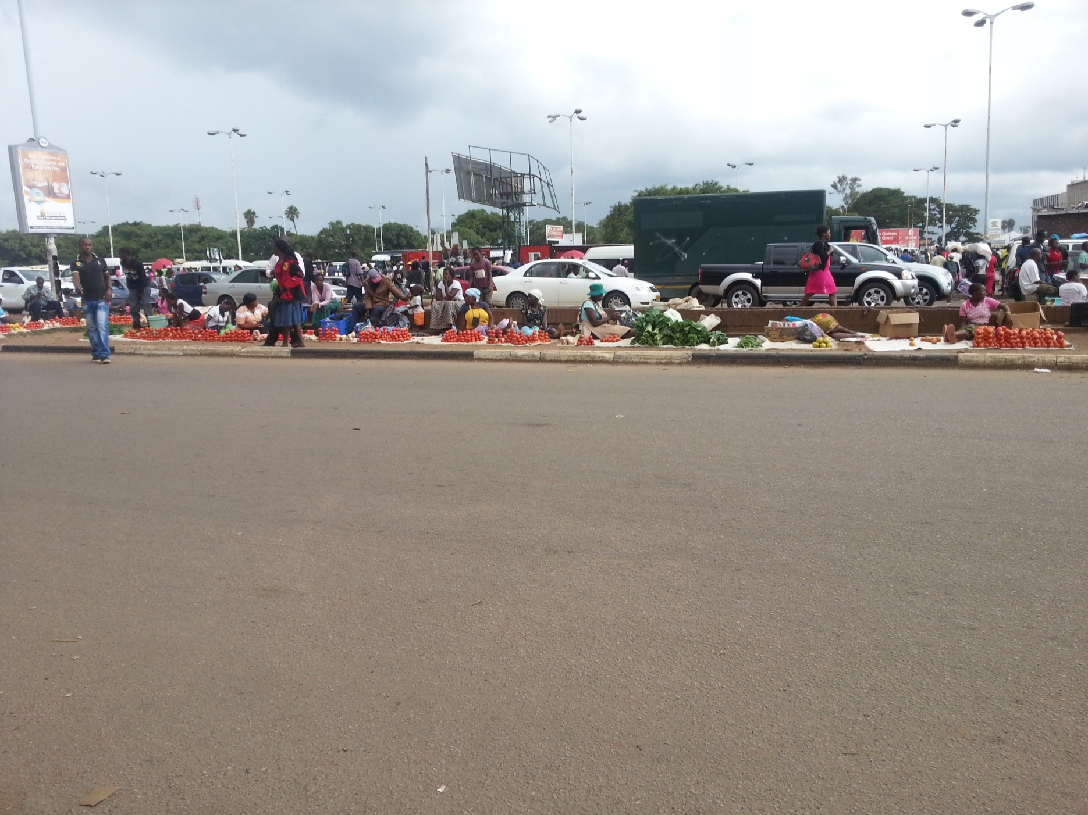
Majority ‘Pavement’ Traders

Slide 18
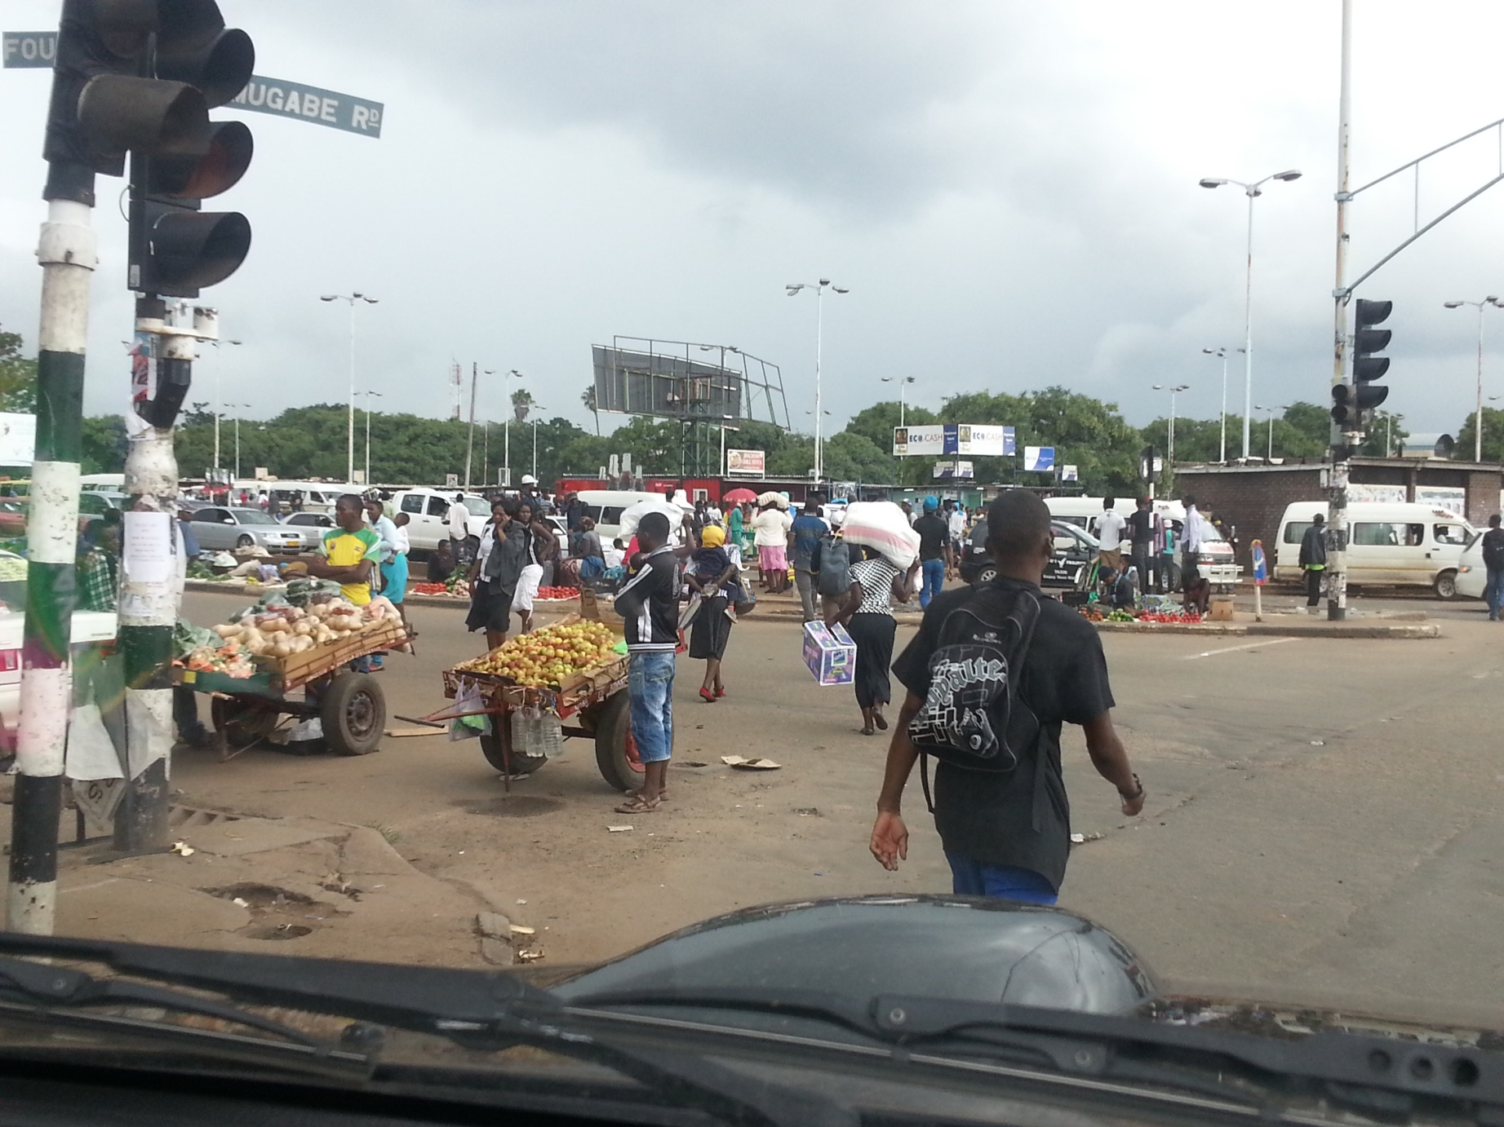
Pushcart Traders

Slide 19
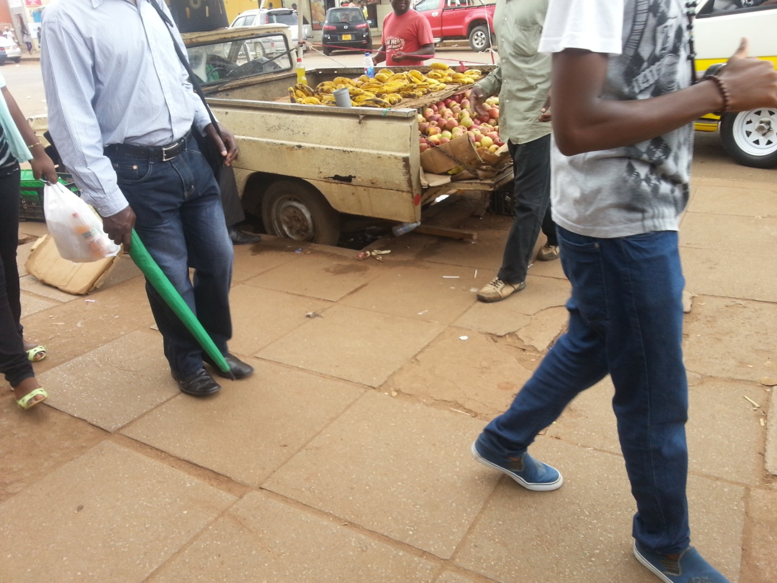
Trading from old vehicle…

Slide 20
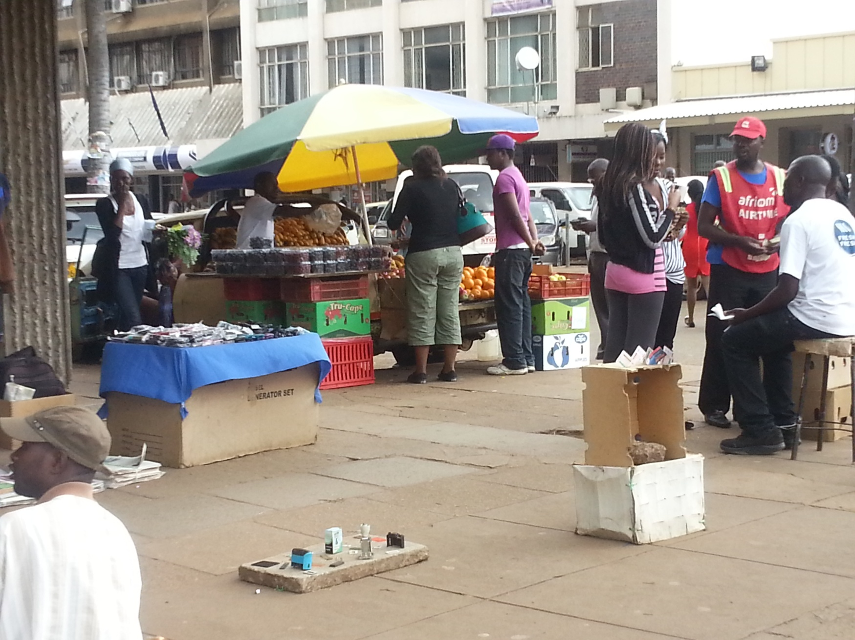

Slide 22
Ratio of farmers to traders=13:107

Slide 23
Range of Food Items Sold on the Streets

Slide 24
Where are the traded food items coming from?

Slide 25
Mapping Sources of Street Food
22%

Slide 26
Unpacking the Wholesale Market (68%)

Slide 27
Imported Food traded on Harare’s streets

Slide 28
How much of the wholesale market food is ‘migrating’ ?.....80% of apples, peaches, grapes

Slide 29
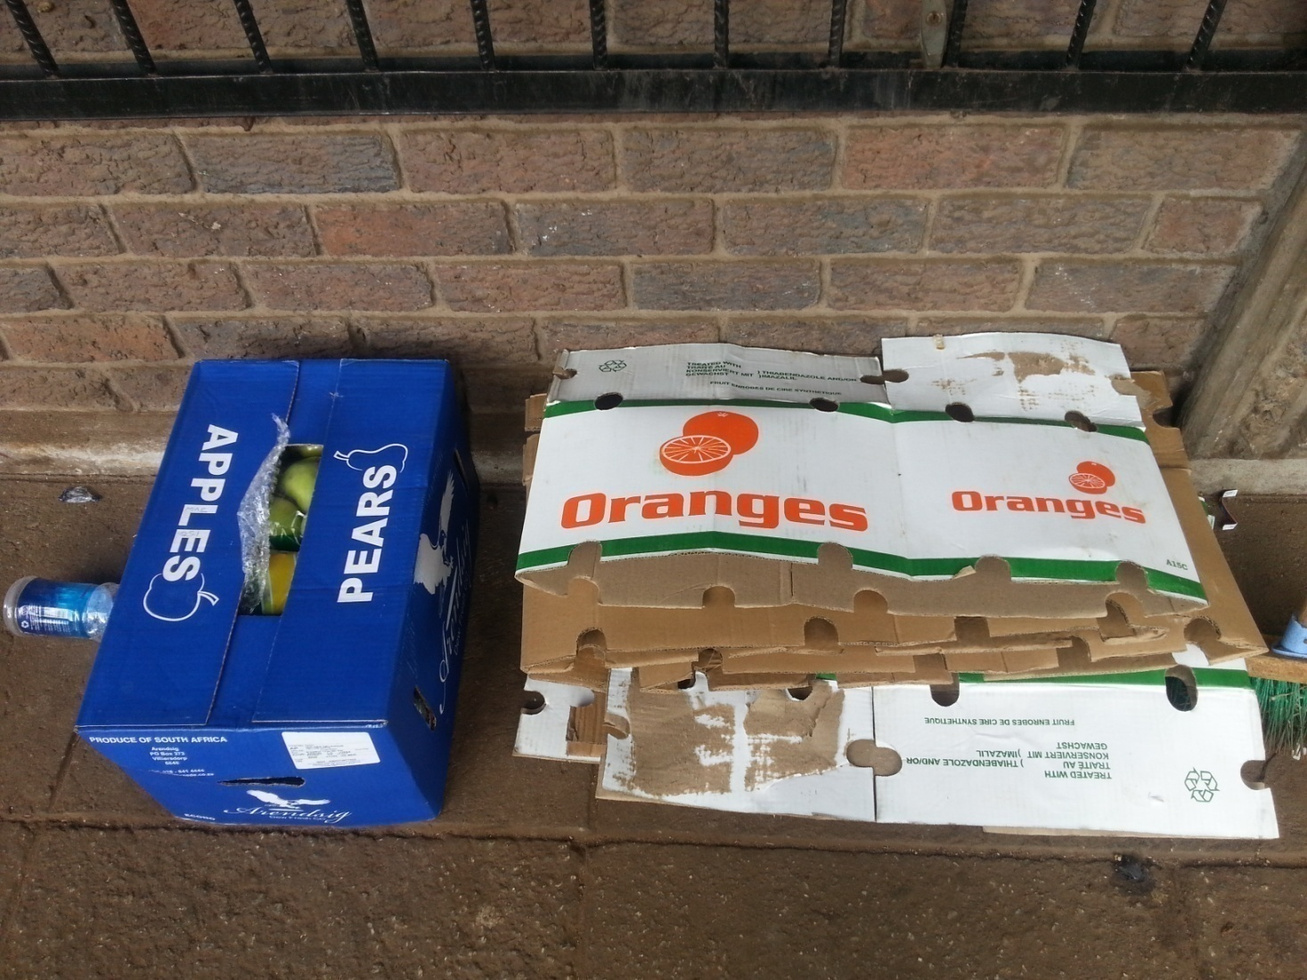
The packaging shows the footprint of apples and oranges

Slide 30
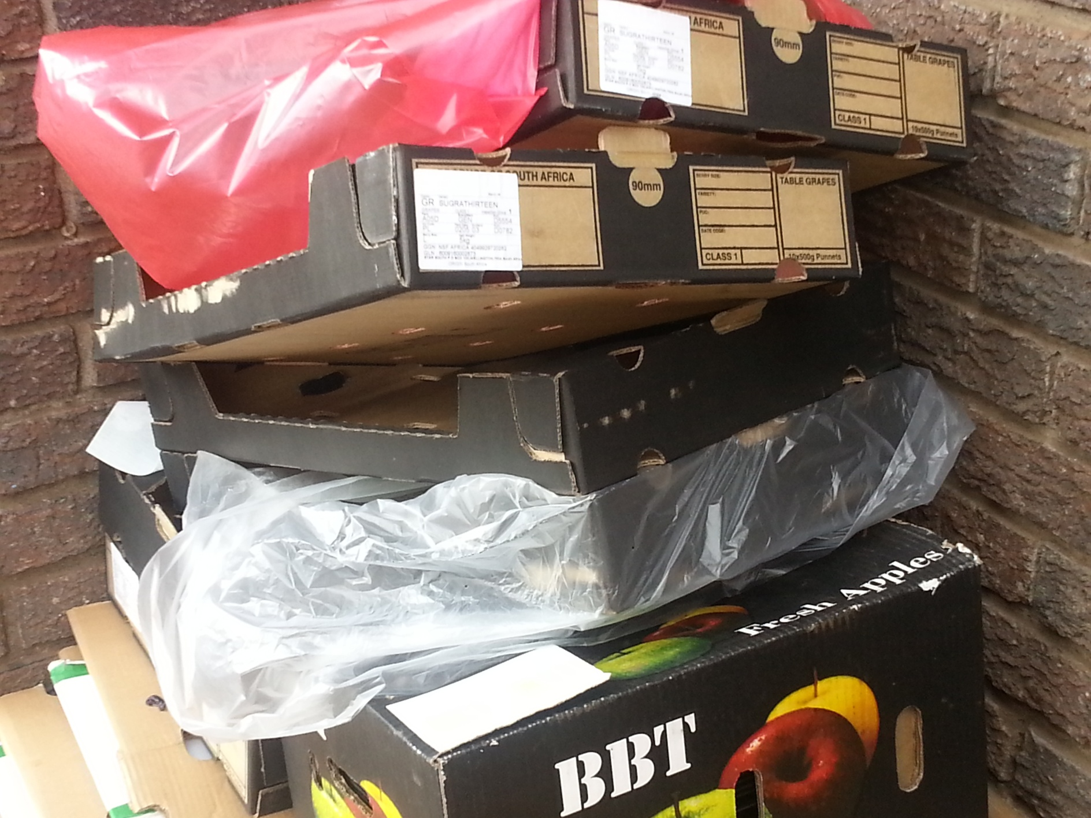
Empty Cartons on the streets of Harare showing origin of produce

Slide 31
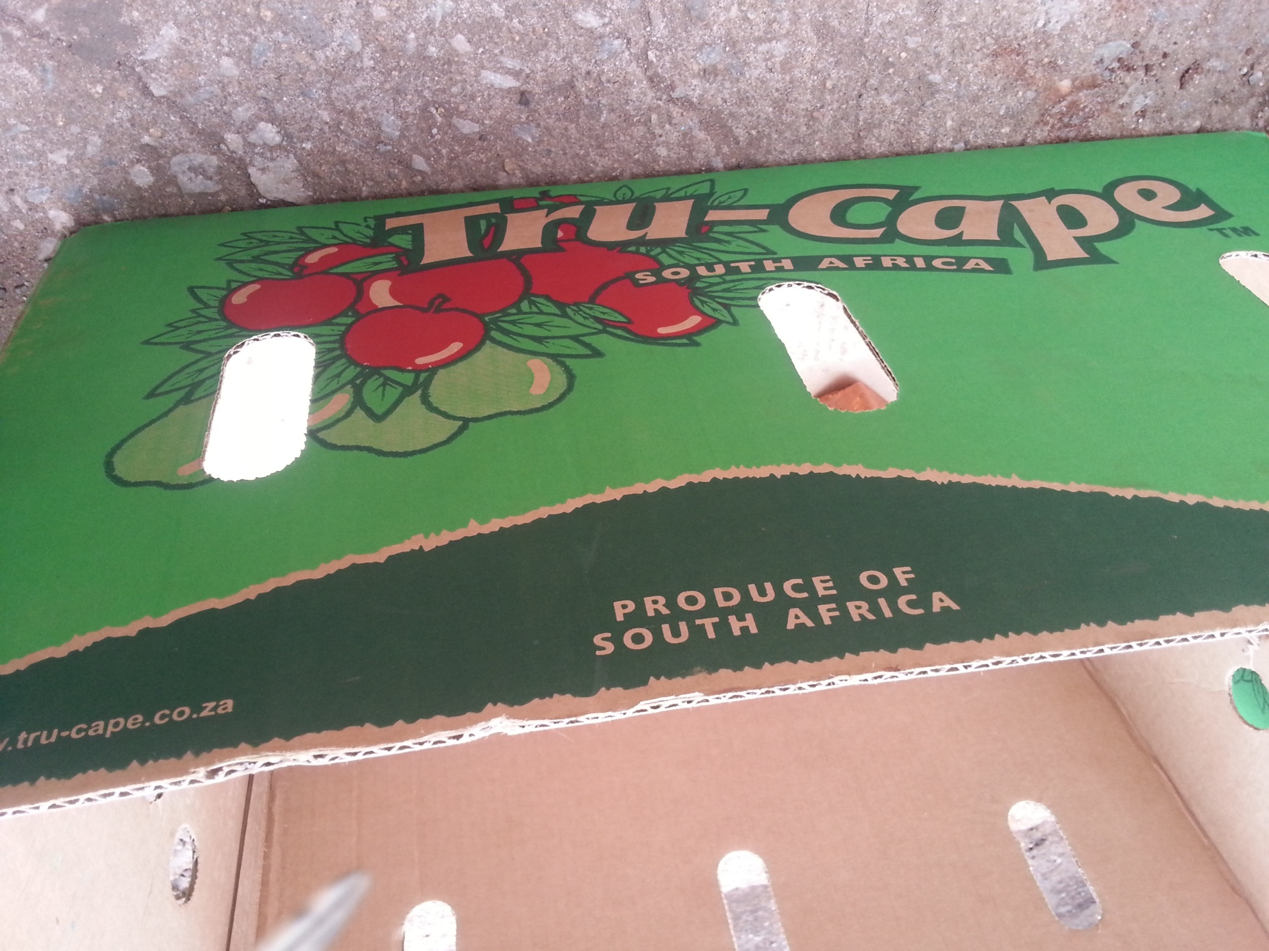
This box is in Harare….3500 kilometres away from the Cape

Slide 32
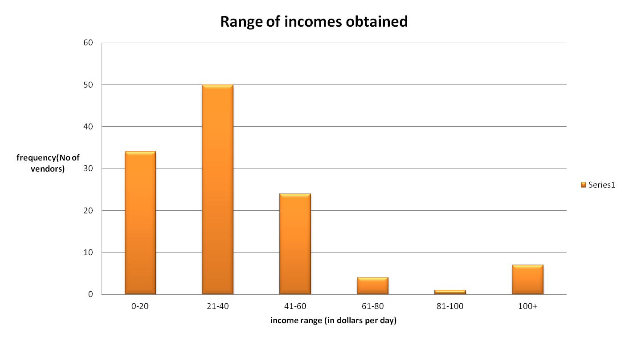
Incomes of traders

Slide 33
Gender dimension of informal food vendors and time of day

Slide 34
Summary of Findings
There is a wide range of food items sold by the informal sector in Harare
Most of the food sold in Harare comes from the peri-urban zone and rural Zimbabwe
Whilst most of the food items are produced in the country, there are certain specific food items that are predominantly imported
These constitute mainly fruits that come from the Cape area of South Africa
The incomes are low but supporting livelihoods
The regulatory environment is very constraining hence traders suffer periodic losses

Slide 35
Challenges
A repressive regulatory framework
“This is potentially a lucrative business but we are working for the municipal police. You either have to pay them something or they will confisticate all your products or arrest you or do both”
“This is an impossible business. If you apply council will say vending is illegal, if you don’t they will still harass you, either way we are the losers”

Slide 36
Challenges cont’d
No infrastructure for the informal sector in most parts of the CBD
Serious losses of produce due to improper storage and handling of produce sold
Health challenges due to limited or no access to sanitary facilities

Slide 37
Traders Coping Strategies
Paying bribes
Arranging with adjacent property owner for storage of excess stock
Organizing watch teams to warn of police raids
Budget for fines
Price mark-ups to accommodate periodic losses
Lobbying with authorities

Slide 38
Limitations of the study
Serious suspicions due to the poisoned regulatory environment….municipal police sometimes raid in plain clothes so the traders do not trust anyone they do not know
The sensitivity of some of the issues to do with incomes discussed made some respondents uncomfortable…researchers ended up asking indirectly
It has been raining so much that numbers observed may not be a true reflection of actual vendors
The research is self-funded and therefore the depth of fieldwork is a reflection of the available capacity

Slide 39
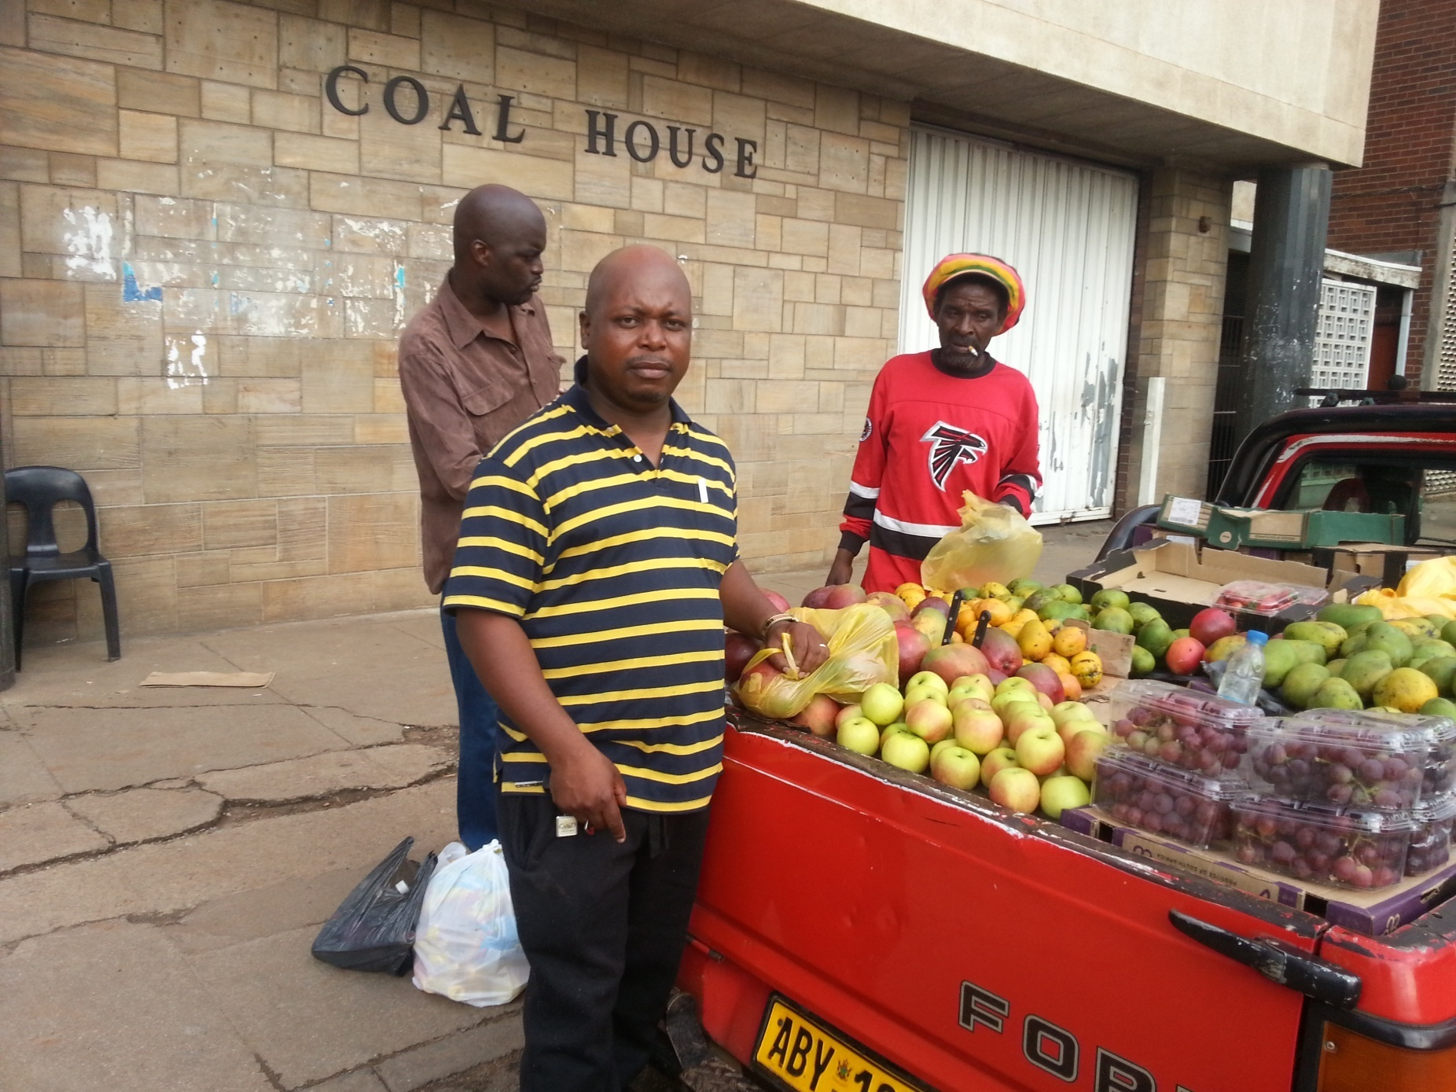
Thank You…Tatenda…Siyabonga

