Slide 1
Dr. Andrew Brooks Department of Geography
Informal Entrepreneurship in Maputo’s Clothing Markets
Urban Informality and Migrant Entrepreneurship in Southern African Cites, Cape Town 2014

Slide 2
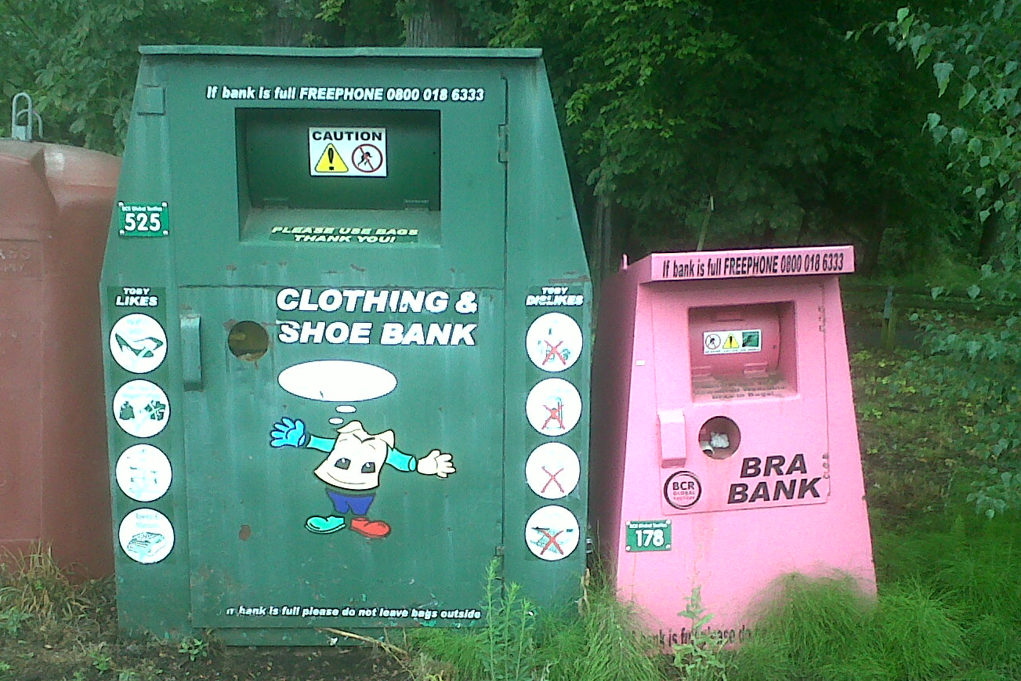
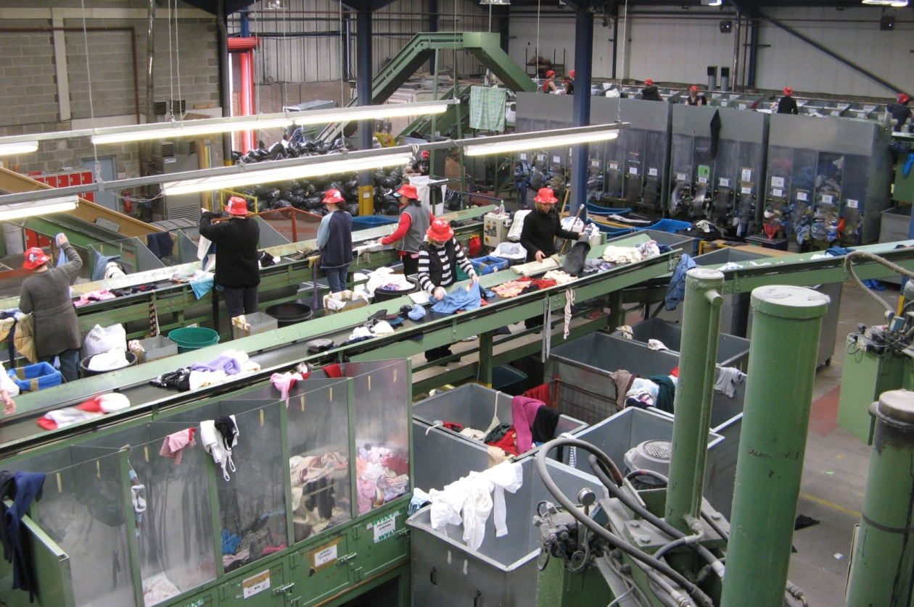
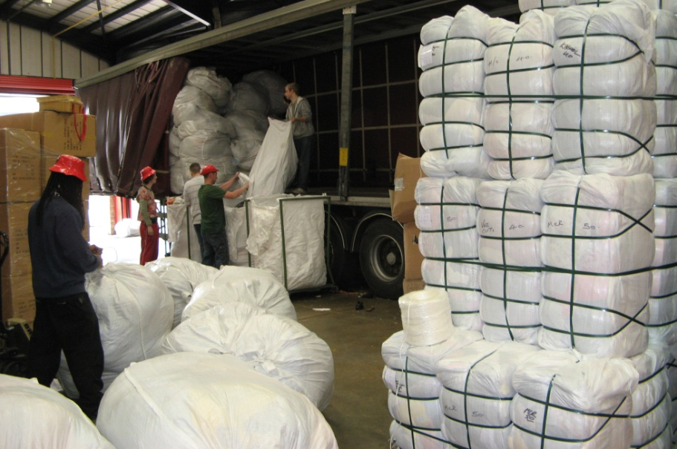
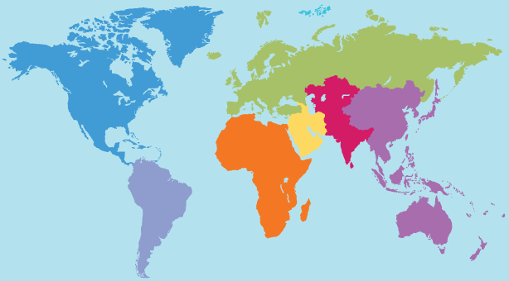
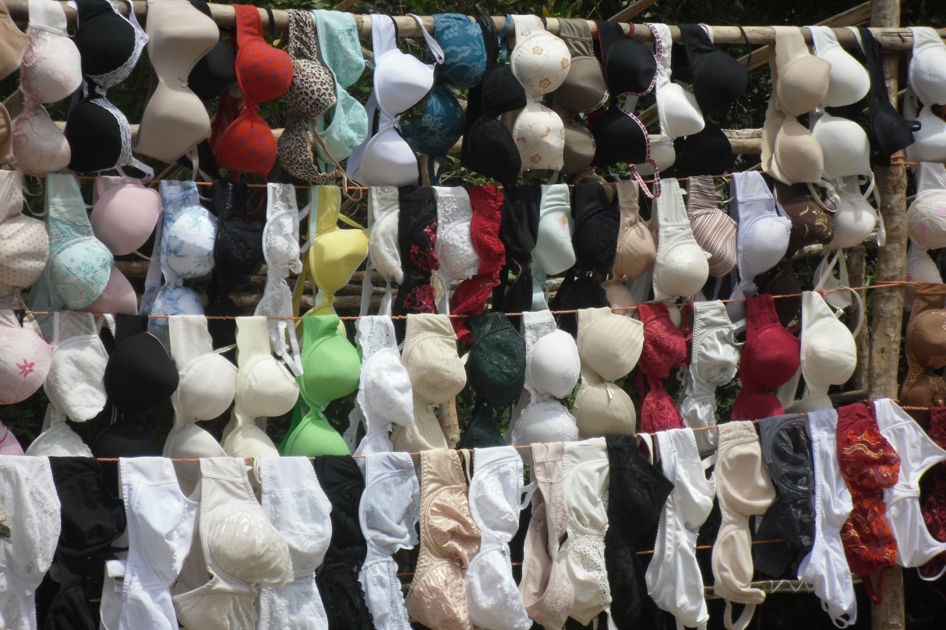
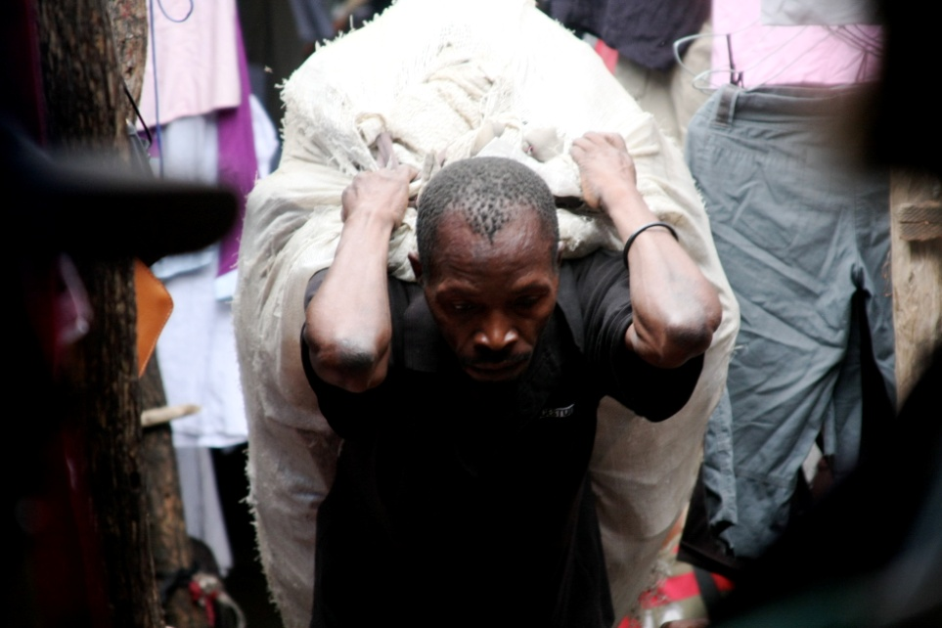
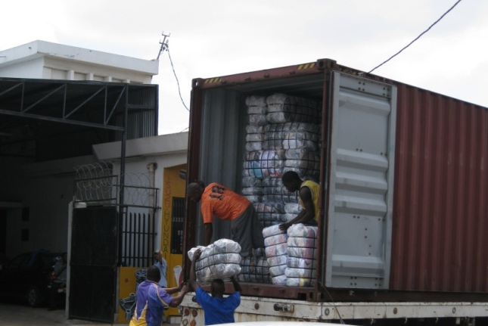
The Second-hand clothing commodity chain

Slide 3
Recorded Mozambican used-clothing imports in US Dollars 1994-2010
UNCOMTRADE (2011) (No Data available for 1998 and 1999 or prior to 1994)

Slide 4
Importing Used Clothing to Mozambique

Slide 5
Used Clothes are sold by individual market traders in Mozambique

Slide 6
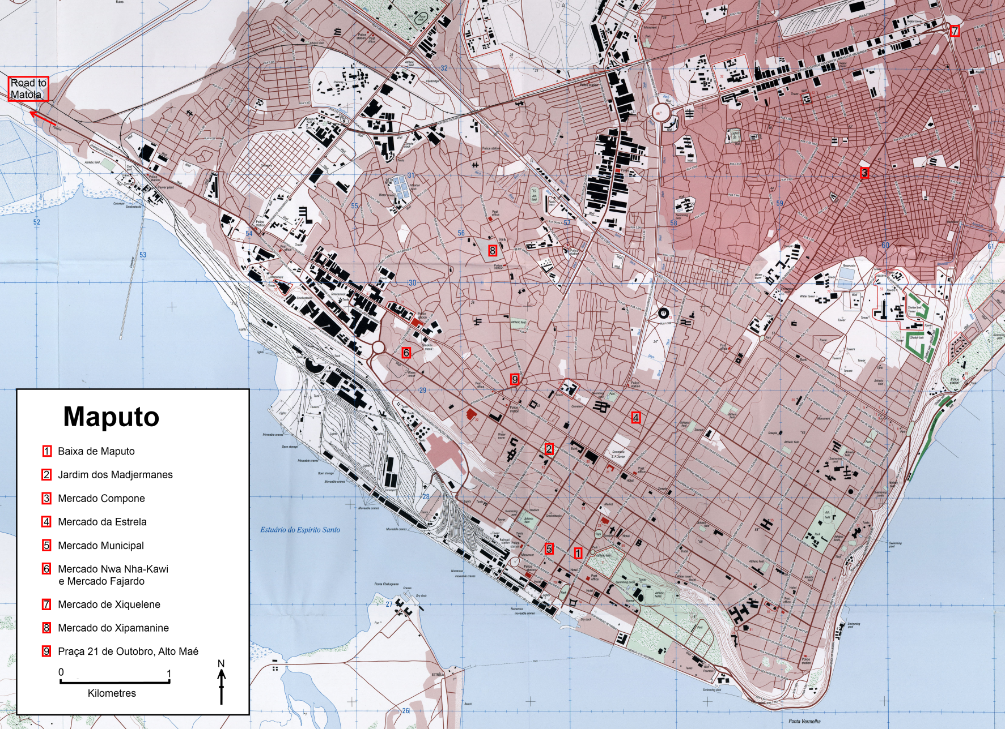

Slide 7
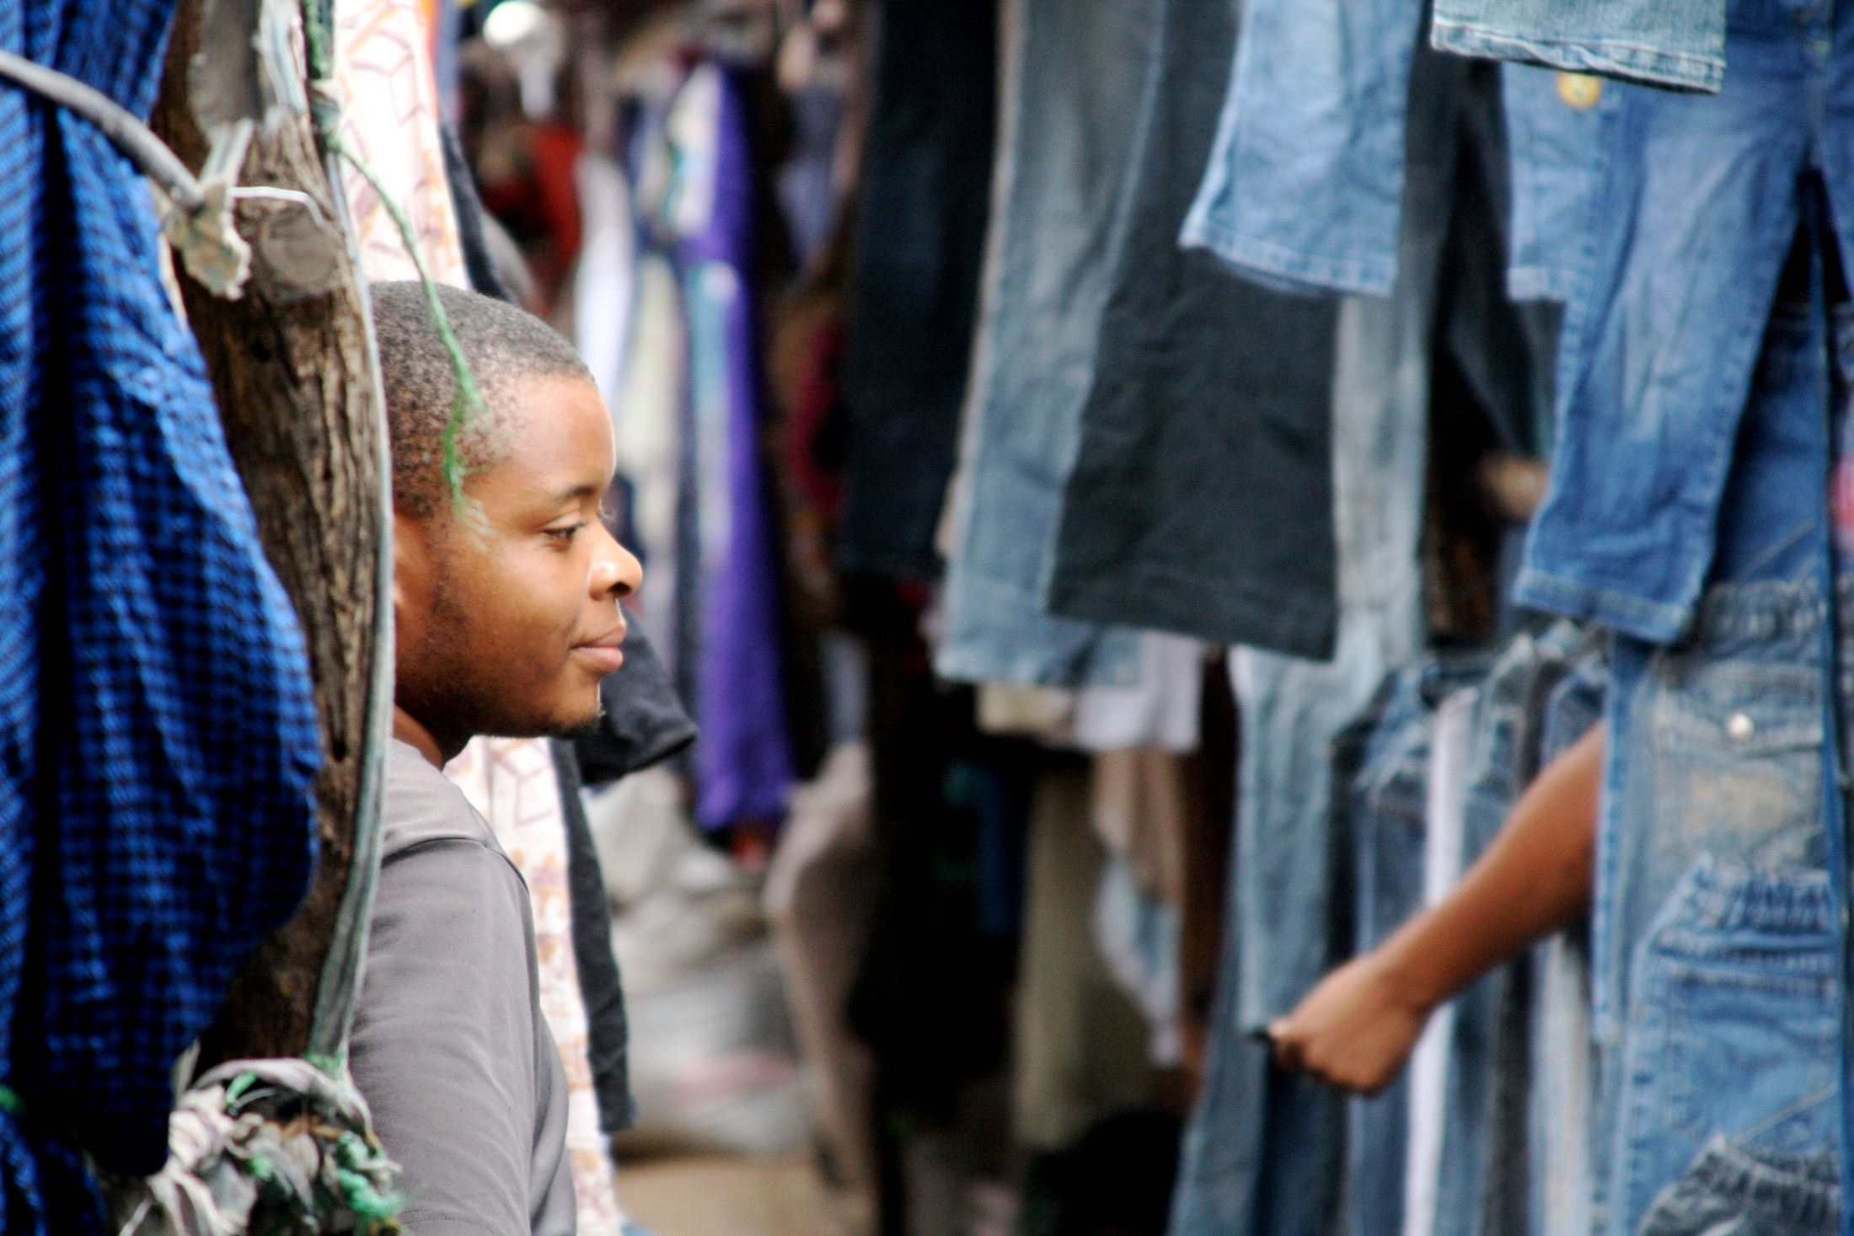
Xipamanine Market

Slide 8
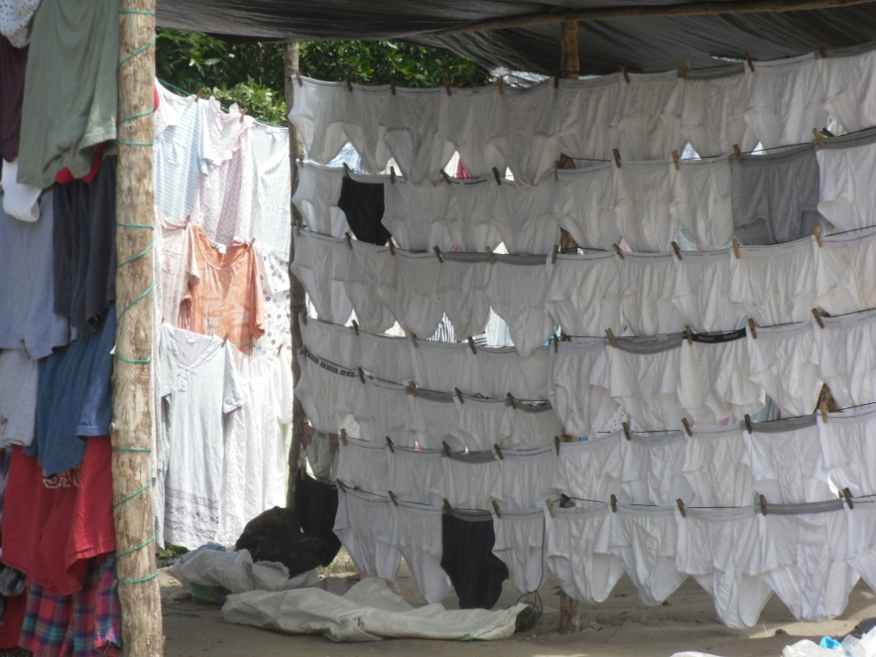
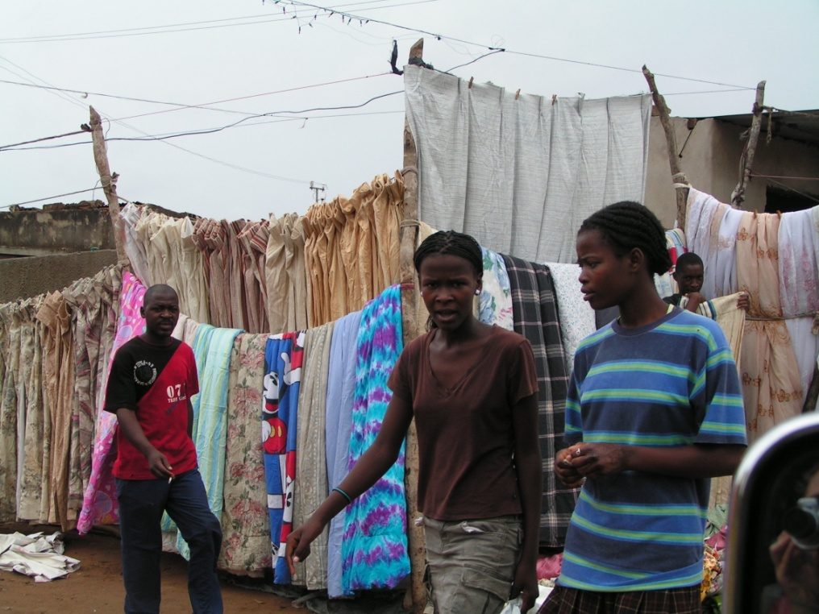
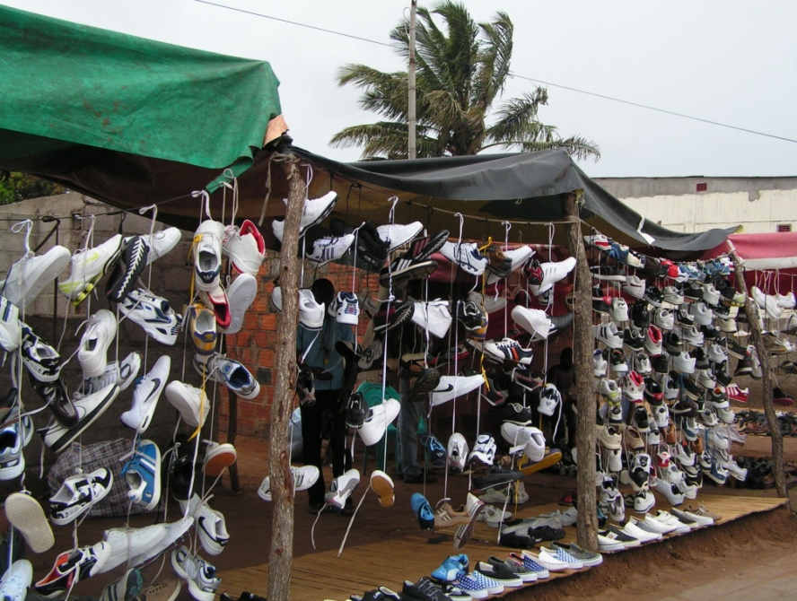
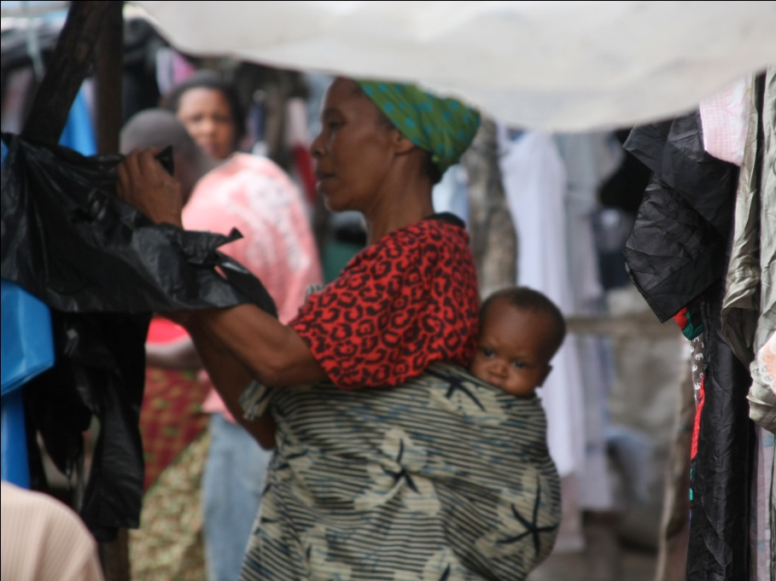

Slide 9
The opening of a bale is a ‘toda bola’ , a lottery where vendors never know what quality of clothes they will find...

Slide 10
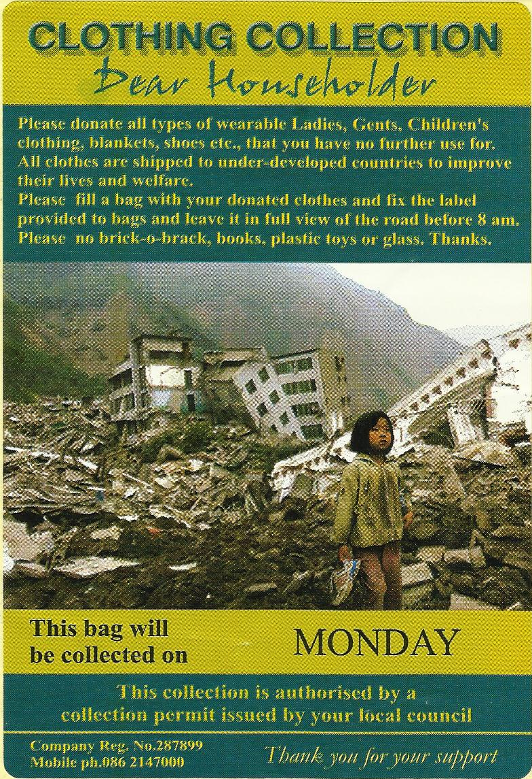
What happens when clothing is donated to a charity or textile recycler in the Global North?

Slide 12
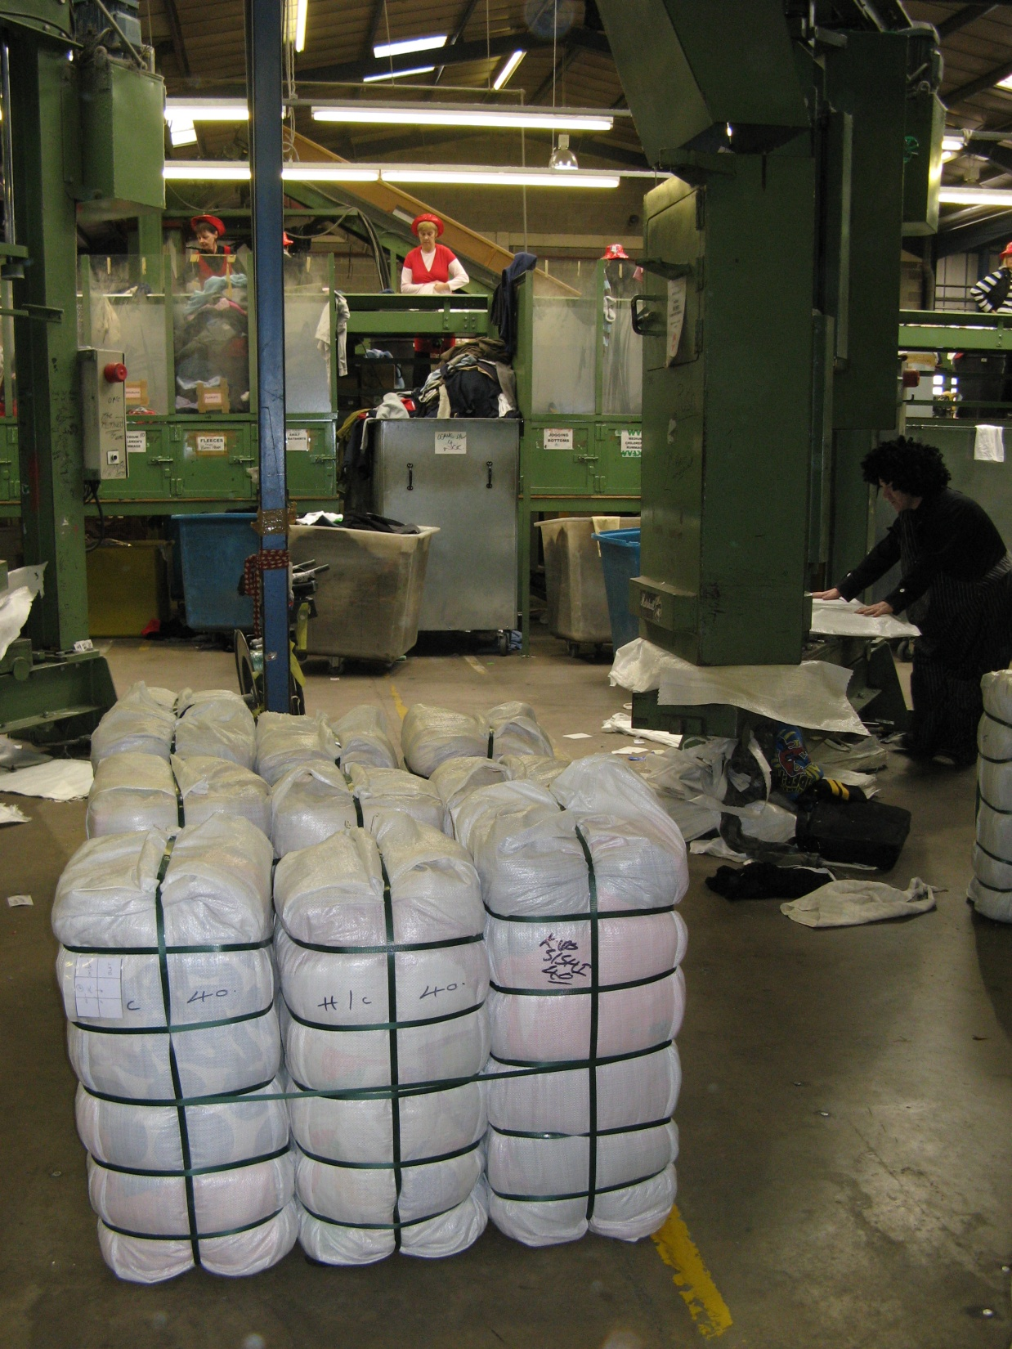
Second-hand clothes get sorted packaged, processed and sold overseas

Slide 13
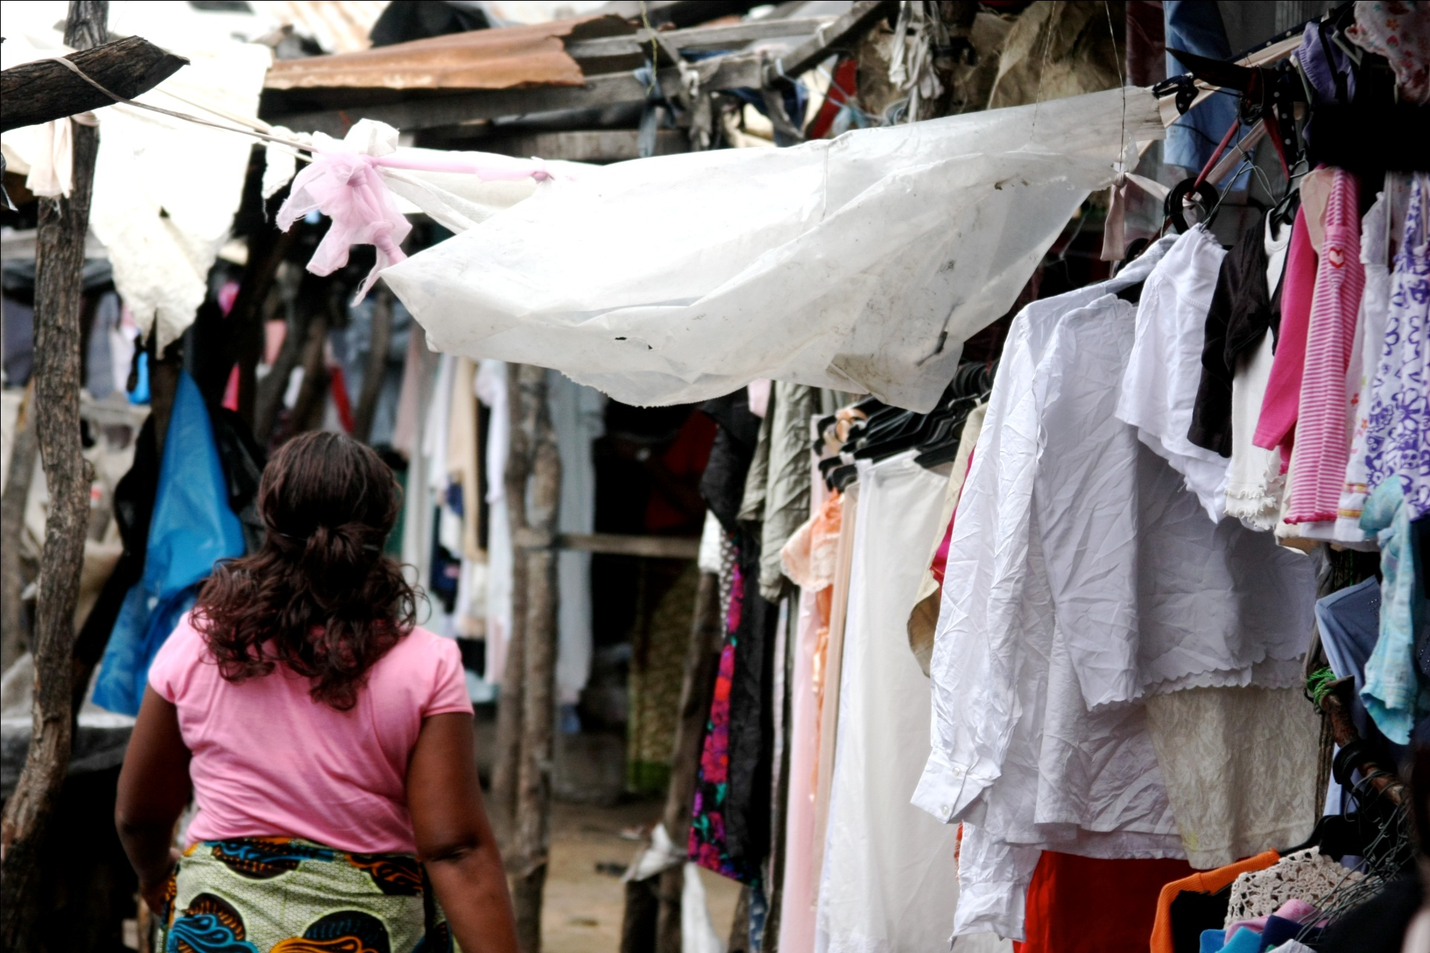
Used clothing is often torn, dirty or low value.

Slide 14
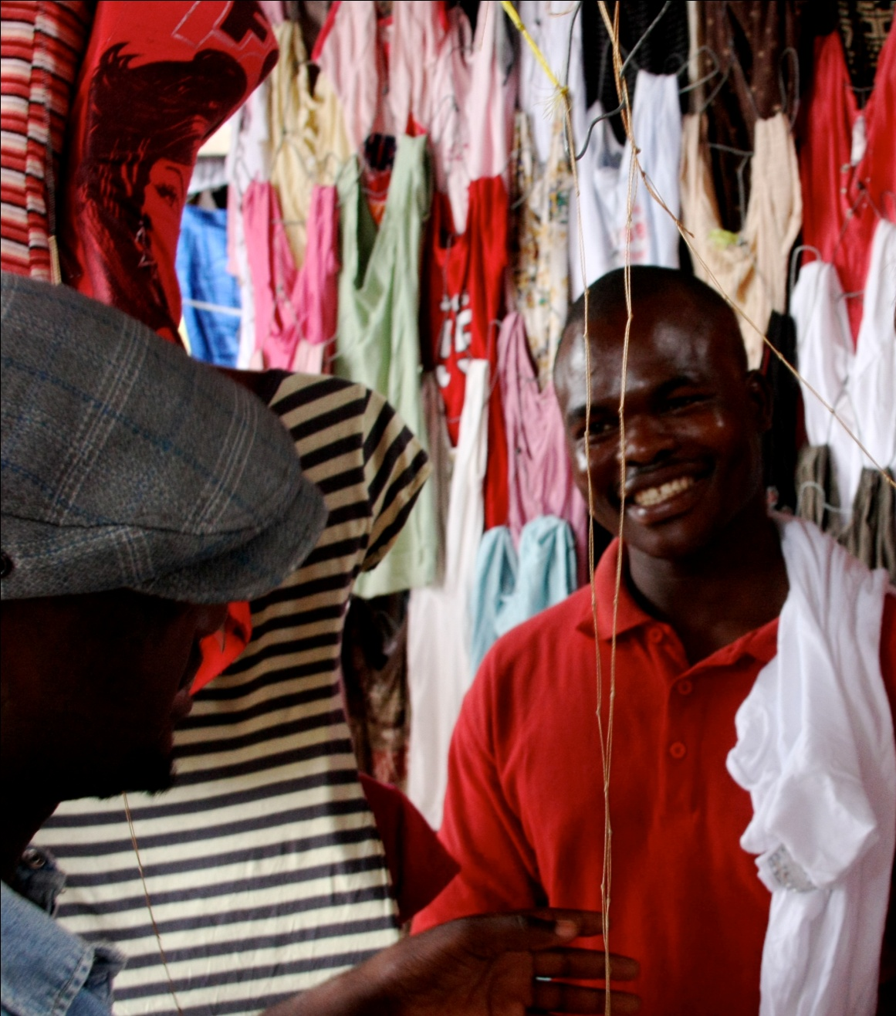
Traders like Eduardo can profit from used clothing sales. Earning approximately $160 per month.

Slide 16
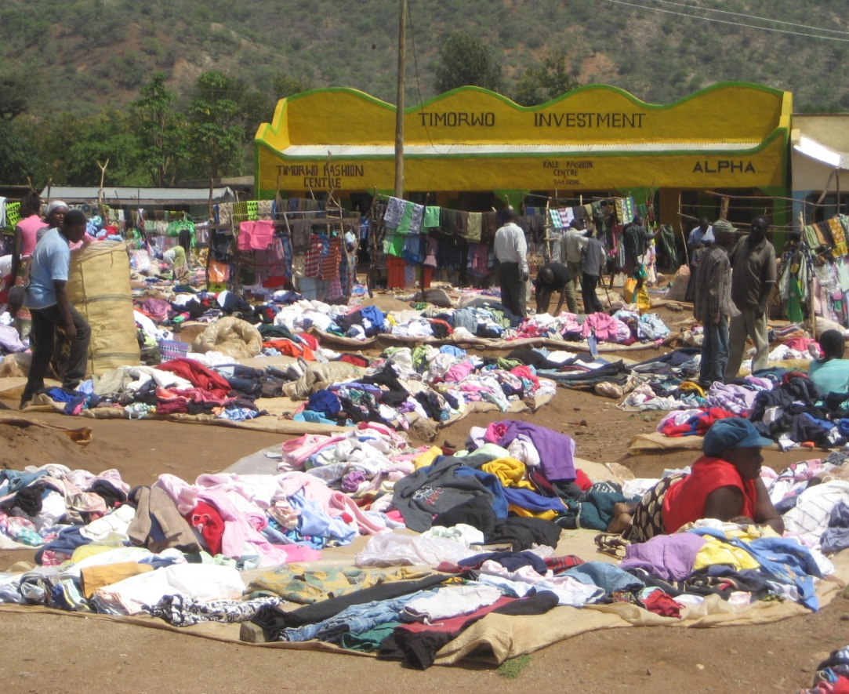
‘One group or class’s discards, or rags, are taken up by another group or class and regarded as riches.’ Palmer and Clark (2005)
African Market Stalls as Fashion Boutiques?

Slide 17
Voice of America (2010)

Slide 18
andrew.brooks@kcl.ac.uk
This presentation draws upon the following published research, please contact the author to receive copies of these papers
Brooks, A. (2013) ‘Stretching Global Production Networks: The International Second-hand Clothing Trade’ Geoforum 44: 10-22.
Brooks, A. (2012) ‘Riches from Rags or Persistent Poverty? The Working Lives of Secondhand Clothing Vendors in Maputo, Mozambique’ Textile: the Journal of Cloth and Culture 10(2): 222–37.
Brooks, A. & Simon, D. (2012) ‘Unravelling the Relationships between Used-Clothing Imports and the Decline of African Clothing Industries’ Development and Change 43(6): 1265-1290

